Slide 1
Basic Writing Skill
Muhammad Ijaz

Slide 2
Content of the Session
• Components of a Sentence
Types of Sentences
• Clauses and Their Types

Slide 3
What are Components of a sentence ?
Sentence structure is the order of all the parts in a sentence:
    subject,
    predicate,
    objects,
    phrases,
    punctuation, etc.
    independent and
    dependent clauses
How they combine (explained below),
    the placement of words and
    phrases next to what they modify,
    as well as the use of proper grammar.

Slide 4
1) Subject:
A noun that carries out the action in a sentence is considered the subject.
It answers the question ‘who’ and
    typically takes precedence,
    especially in declarative or assertive sentences.

Slide 5
For example:
• The birds are singing outside my window.
• A diligent student always completes assignments on time.
• The diligent student always completes assignments on time.
• Someone left an umbrella in the hallway.

Slide 6
2) Predicate
A predicate is the part of a sentence that tells us
    what the subject does,
    what happens to the subject, or
    what the subject is like.
Formula:
    Sentence = Subject + Predicate

Slide 7
Example
The birds are singing outside my window.
    Subject: The birds
    Predicate: are singing outside my window
The predicate tells us what the birds are doing.

Slide 8
Example 2
A diligent student always completes assignments on time.
    Subject: A diligent student
    Predicate: always completes assignments on time
The predicate explains what the student does.

Slide 9
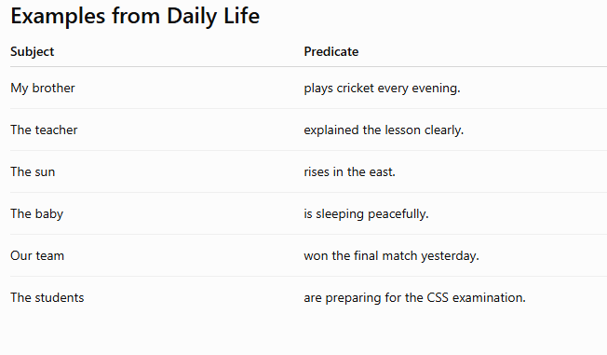

Slide 10
3) Objects
An object is the
      noun,
      pronoun, or
      noun phrase
that receives the action of the verb.
It answers the questions "What?" or "Whom?" after the action verb.
Formula:-
      Subject + Verb + Object

Slide 11
A Simple Trick to Find the Object
Step 1:
      Find the verb (action).
Step 2:
      Ask the question:
      What?
      Whom?
The answer is the object.

Slide 12
Example 1
The birds built a nest.
      Subject: The birds
      Verb: built
      Ask: Built what?
      Answer:
          a nest (Object)

Slide 13
Example 2
A diligent student completes assignments on time.
      Subject: A diligent student
      Verb: completes
      Ask: Completes what?
Answer:
      assignments (Object)

Slide 14
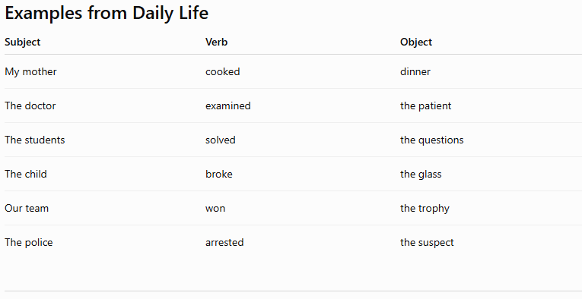

Slide 15
When There Is No Object
Not every sentence has an object.
Example:
      The baby slept peacefully.
      Subject = The baby
      Verb = slept
Ask: Slept what?
      No answer.
Therefore, there is no object.

Slide 16
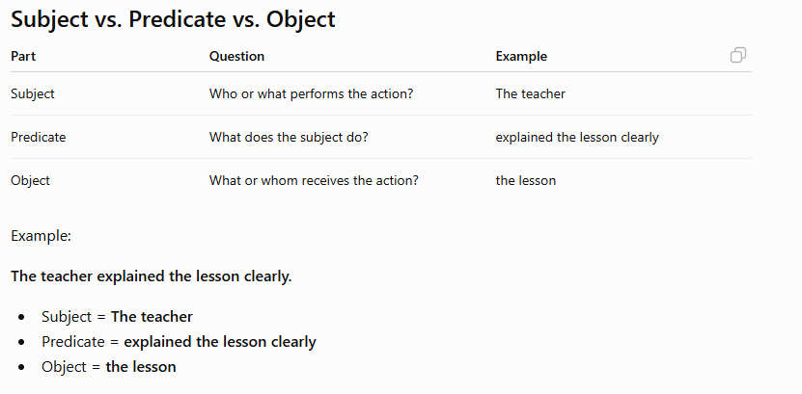

Slide 17
Quick Practice
Find the object in each sentence.
    The chef prepared a delicious meal.
    Sarah bought a new laptop.
    The police caught the thief.
    My brother repaired the bicycle.
    The students completed the worksheet.

Slide 18
Find the object in each sentence.
    The chef prepared a delicious meal.
    Sarah bought a new laptop.
    The police caught the thief.
    My brother repaired the bicycle.
    The students completed the worksheet.

Slide 19
Golden Rule
The subject
    performs the action,
the verb
    expresses the action, and
the object
    receives the action.
Note:-
    If you cannot answer "What?" or "Whom?" after the verb, the sentence does not have an object.
    This simple test works for most English sentences and
    is an excellent trick for identifying objects quickly in grammar exercises.

Slide 20
Phrases
A phrase is
      a small group of words
      that communicates a concept but isn’t a full sentence.
You use phrases in
      your writing and
      your speech every day.
There are lots of different kinds of phrases,
      some of which play a technical role in your writing and
      others that play a more illustrative role.
No matter which role a phrase is playing,
      it’s achieving one simple goal:
      making your sentences richer by giving your words
          context,
          detail, and
          clarity.

Slide 21
?
A phrase is a group of
      related words that does not contain both
          a subject and
          a finite verb and
          does not express a complete thought.

Slide 22
Think of It Like a Pizza Slice
A sentence is a whole pizza.
    A phrase is just one slice.
A slice is delicious, but it cannot satisfy you alone.
Likewise, a phrase cannot express a complete idea by itself.

Slide 23
Example
The little boy is playing football.
Phrase:
      The little boy
Does it have a subject?
      "Boy" is a noun, but there is no verb.
Therefore,
      The little boy = Phrase

Slide 24
Example
She is sitting under the tree.
Phrase:
      under the tree
Ask:
      Does it contain a subject and a verb?
      No.
Therefore,
      under the tree = Phrase

Slide 25
Think of It Like a Train
Imagine a train.
Sentence =
      Complete Train
Phrase =
      One Coach
      One coach cannot reach the destination alone.
      It must join the whole train.
Similarly,
      A phrase needs a sentence to express a complete meaning.

Slide 26
Common Types of Phrases
1. Noun Phrase
2. Verb Phrase
3. Prepositional Phrase
4. Adjective Phrase
5. Adverb Phrase

Slide 27
1. Noun Phrase
Acts like a noun.
Examples:
      the intelligent student
      a beautiful garden
      my best friend
      those expensive books
Sentence:
      The intelligent student won the competition.

Slide 28
2. Verb Phrase
Contains the main verb and helping verb(s).
Examples:
      is writing
      has finished
      will be studying
      had been waiting
Sentence:
      She has completed her assignment.

Slide 29
3. Prepositional Phrase
Begins with a preposition.
Examples:
      in the classroom
      under the table
      across the river
      after the meeting
Sentence:
      The students are waiting outside the hall.

Slide 30
4. Adjective Phrase
Describes a noun.
Examples:
      full of energy
      rich in culture
      eager to learn
Sentence:
      The boy full of energy won the race.

Slide 31
5. Adverb Phrase
Describes a verb, adjective, or another adverb.
Examples:
      with great enthusiasm
      in a hurry
      very carefully
      at once
Sentence:
      She answered the question with great confidence.

Slide 32
Clause
A clause is
      a group of related words
      that contains a subject and a finite verb.
It expresses
      a complete or incomplete thought,
      depending on its type.
Formula:-
      Clause = Subject + Finite Verb

Slide 33
Think of It Like a Car 🚗
Imagine a car.
  🚗 Engine = Subject
  ⛽ Fuel = Finite Verb
Without the engine,
      the car cannot move.
      Without fuel, the engine cannot work.
A clause needs both the subject and the finite verb to function.

Slide 34
Example
The birds are singing outside my window.
Clause:
      The birds are singing
      Subject = The birds
      Finite Verb = are singing
It is a clause because it has both.

Slide 35
Example 2
She completed her assignment.
    Subject = She
    Finite Verb = completed
This is a clause.

Slide 36
Types of Clauses
Two Types of Clauses
    1. Independent Clause
    2. Dependent (Subordinate) Clause

Slide 37
1. Independent Clause
An independent clause expresses
      a complete thought and can stand alone as a sentence.
Examples
        Ali plays cricket.
        The teacher explained the lesson.
        We enjoyed the workshop.
        The train arrived on time.
Each has:
        Subject
        Finite Verb
        Complete meaning

Slide 38
2. Dependent (Subordinate) Clause
A dependent clause has
      a subject and a finite verb,
      but it does not express a complete thought.
It depends on another clause.
Examples
      because she was ill
      although he worked hard
      if you study regularly
      when the lecture ended
      These leave the listener waiting for more information.

Slide 39
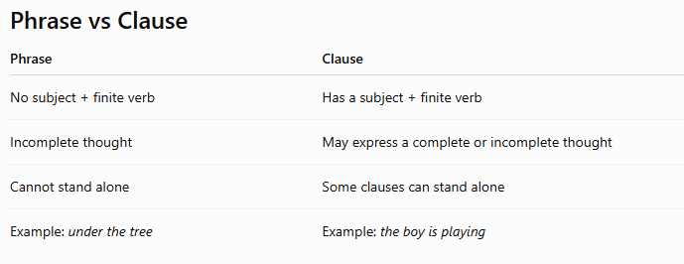

Slide 40
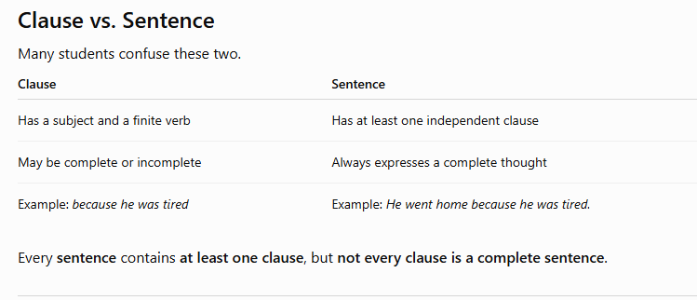

Slide 41
Sentence and its Types
An English Sentence is
    a group of words
    that shares a complete thought,
    usually following a subject-verb-object order.
The four main types of sentences are
    declarative (statements),
    interrogative (questions),
    Exclamator
    and imperative (commands).

